Slide 1
Blockchain Technology
From a Developer’s Perspective
-- Xiaofang Yu
xiaofangyu7@gmail.com

Slide 2
Agenda
What is Blockchain?
How does a Blockchain work?
Where to use Blockchain?

Slide 3
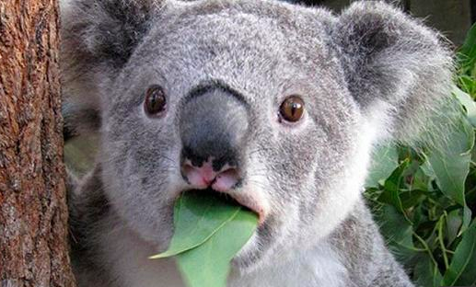
Blockchain - https://en.wikipedia.org/wiki/Blockchain
A blockchain, originally block chain, is a continuously growing list of records, called blocks, which are linked and secured using cryptography. Each block typically contains a cryptographic hash of the previous block, a timestamp and transaction data. ... It is "an open, distributed ledger that can record transactions between two parties efficiently and in a verifiable and permanent way". For use as a distributed ledger, a blockchain is typically managed by a peer-to-peer network collectively adhering to a protocol for inter-node communication and validating new blocks. Once recorded, the data in any given block cannot be altered retroactively without the alteration of all subsequent blocks, which requires collusion of the network majority.
Blockchains are secure by design and exemplify a distributed computing system with high Byzantine fault tolerance. Decentralized consensus has therefore been achieved with a blockchain.
… ...
…

Slide 4
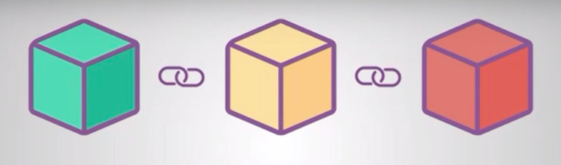
What is Blockchain?
- It is a chain of Blocks!
Eh… What is a BLOCK? How do they CHAIN together?

Slide 5
SHA 256 Hash
SHA (Secure Hash Algorithm) 256 Hash
cryptographic hash function
Unique ‘signature’ for a text or a data file
Fixed length: 256-bit (32-byte)

Slide 6
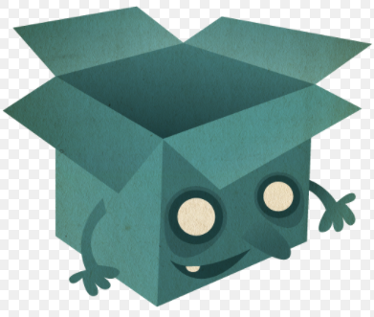
What is a Block?
Block
Prev Hash | 0
Timestamp | Thu, 05 April, 2018 16:18:00 PST
Data | $100: Lucy -> Lily ...
Hash | 000026b4926f75300a...
Nonce | 86593

Slide 7
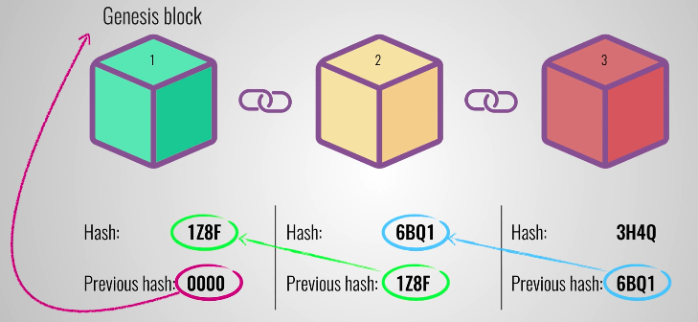
Block -> Blockchain
A block is a chunk of data (one or more valid transactions)
Each block has the cryptographic hash of the prior block (linked together)
Linked blocks form a chain -> can iterate all the way back to the genesis block
A Blockchain is a chain of blocks
A distributed database system
Maintains a continuously growing “open ledger”

Slide 8
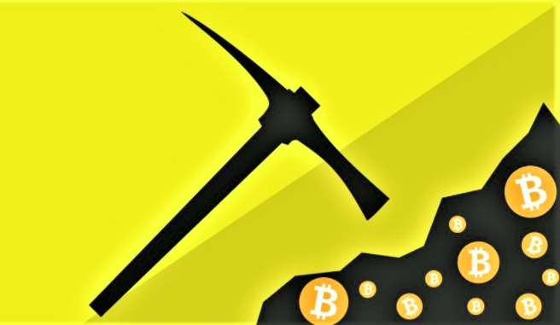
How does a Blockchain work?
Block Generation
The process of block generation is also called “Mining”.
You might also have heard about “Miner” or “Mining Machine”.
Transactions are constantly being processed by miners into blocks which are then added to the end of the chain.

Slide 9
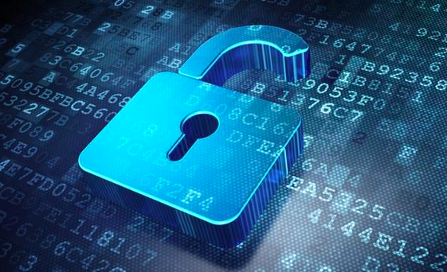
How does a Blockchain work?
Cryptography
Blocks are linked and secured using cryptography.
Modification of existing data is very hard or even impossible.
Validation required: ownership integrity, data integrity, and transaction integrity.
Once recorded, the data cannot be altered without the alteration of all subsequent blocks.

Slide 10
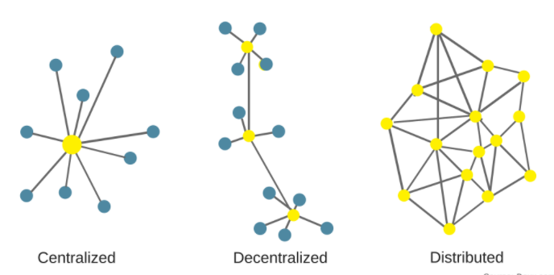
How does a Blockchain work?
Decentralization
Not one single entity has control over all the processing.
storing data across a peer-to-peer network.
Every node in this decentralized system maintains a copy of the blockchain.
Data quality is maintained by massive database replication and computational trust.

Slide 11
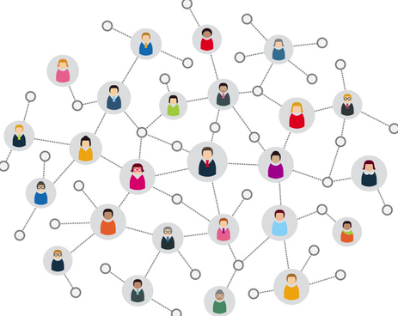
How does a Blockchain work?
Consensus
No centralized "official" copy exists and no user is "trusted" more than any other.
Consensus can be achieved using Proof-of-Work.
Consider a block as valid only if the majority (50%) verifies the block and finally all nodes reach a consensus on the new block.
There are different consensus algorithms.

Slide 12
Scenario - cryptocurrency
Data - transactions
Block - a group of transactions
Blockchain - a ledger
Essence - Participants in the network govern and maintain the ledger by consensus

Slide 13
Where to use Blockchain?
Cryptocurrency , such as Bitcoin, Litecoin, Ethereum ...
Banking and Payments
Identity Management
Cyber Security
Food Traceability
Supply Chain Management
Healthcare
…

Slide 14
References
https://en.wikipedia.org/wiki/Blockchain
https://blockgeeks.com/guides/what-is-blockchain-technology/
https://www.quora.com/What-is-blockchain-technology-1
https://blockgeeks.com/guides/cryptocurrencies-cryptography/
https://www.youtube.com/watch?v=SSo_EIwHSd4
https://mastanbtc.github.io/blockchainnotes/consensustypes/

